Slide 2


What are anomalies?
Anomalies:
patterns in data that do not conform to a well defined notion of normal behavior.
Anomaly detection approach:
to define a region representing normal behavior and declare any observation in the data which does not belong to this normal region as an anomaly.

Slide 3
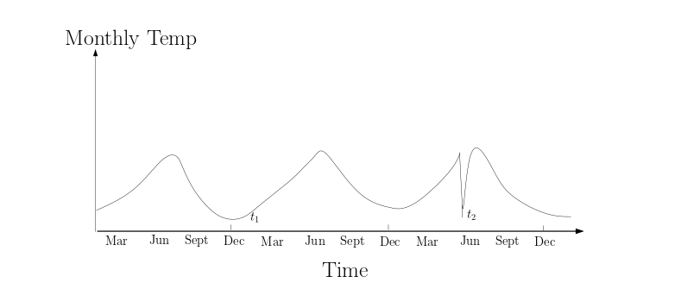
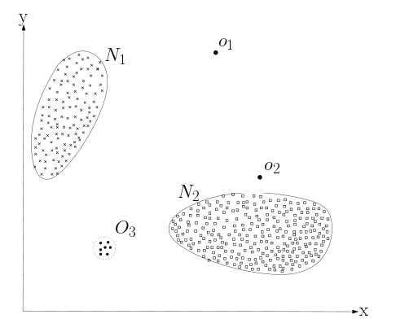
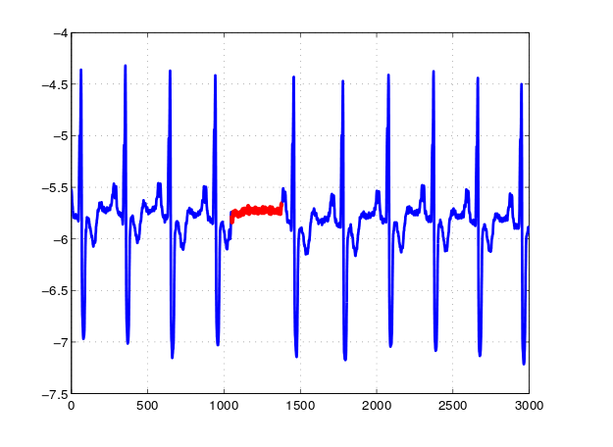
Type of anomaly
Pic 2. Contextual anomaly t2
in a temperature time series.
Pic 1. Point Anomalies in a 2-dimensional data set
Pic 3. Collective anomaly in an human electrocardiogram output

Slide 4
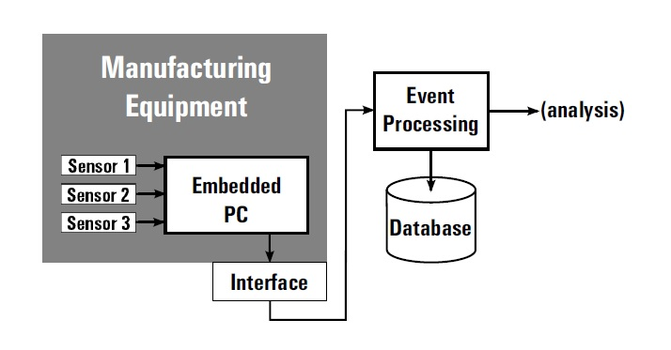
Application of anomaly detection
Sensor Networks: streaming mode
sensors are faulty, or they are detecting events (such as intrusions)

Slide 5

Anomaly Detection Techniques
Classification
Nearest Neighbor
Clustering

Slide 6
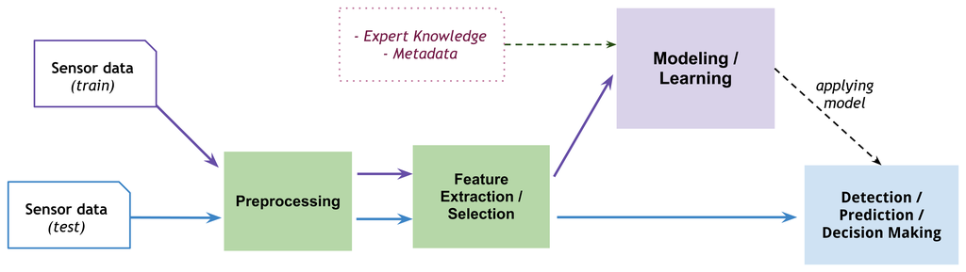
Anomaly Detection Techniques
Classification

Slide 7
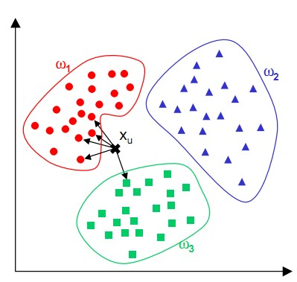
Anomaly Detection Techniques
K-nearest Neighbor (KNN)

Slide 8
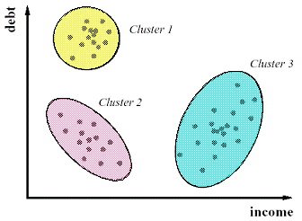
Anomaly Detection Techniques
Clustering

